Slide 1
MISSO Case Competition
Group 20
Christina Pham

Slide 2
Agenda
01
02
03
04
MISSO
Off Black | Report
Webpage Escape Room
Shareholder Automation
Off Black | Report
EMAJJ
Sales and Order Report
Website Design

Slide 3
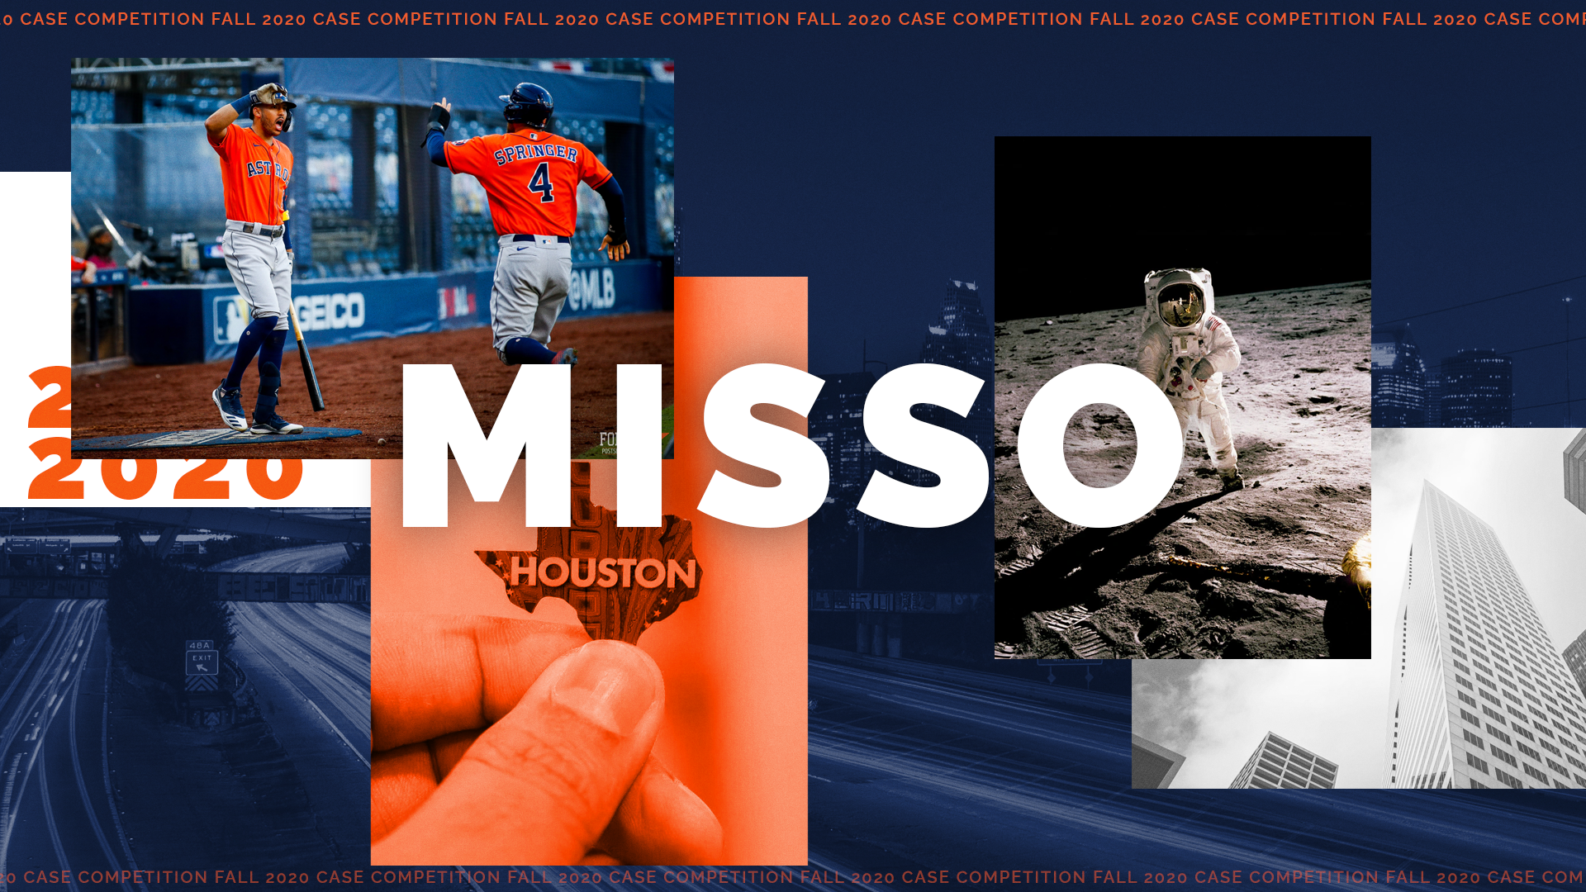
Notes:
Objective: Fix HTML within given source document

Slide 4
ChristinaPhamN.github.io/MISSO_Case-Competition

Slide 5
Process
Design Mockup
Completed Challenges
Host on Github
02
04
01
03
05
Restructured Base Code
Script CSS

Slide 6
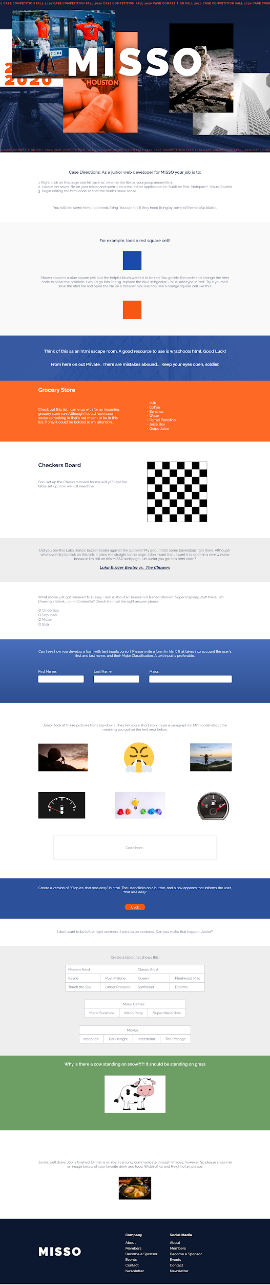
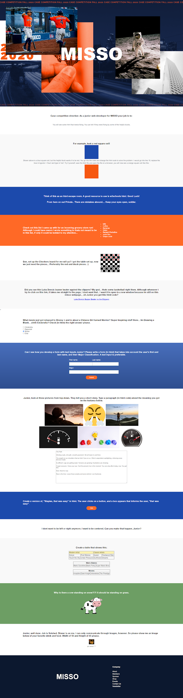
Design
Mockup
Final

Slide 7
DEMO
MISSO HTML Escape Room

Slide 8

Notes:
Streetwear brand

Slide 9
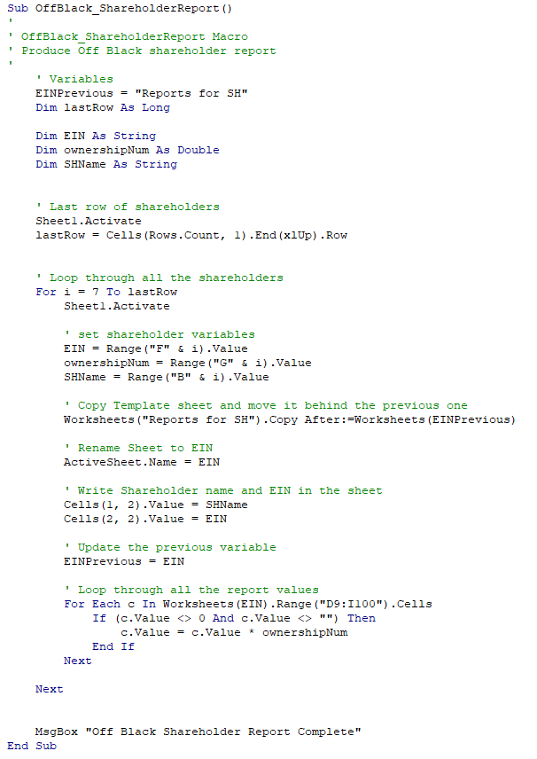
Automation | VBA
DEMO

Slide 10


Slide 11
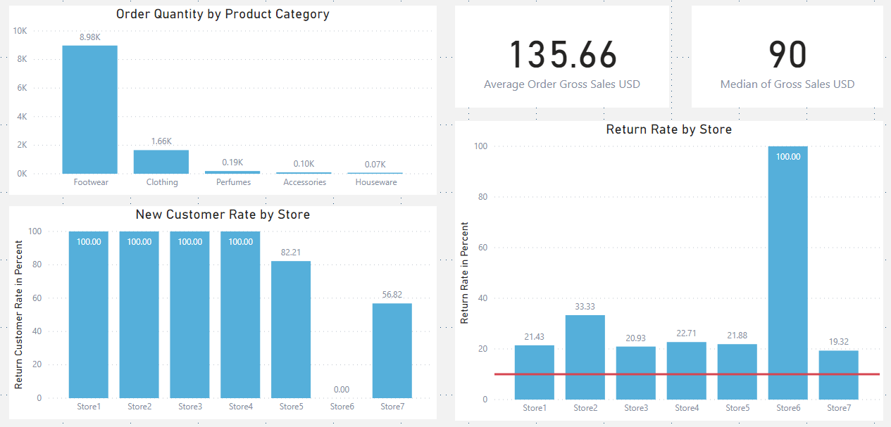
Findings
Order Product Breakdown
Return Rate
New Customer Acquisition
Sales Order

Slide 12
Recommendations
Expand Product Mix
Increase promotions of non-footwear products
Provide sample or free gift of non-footwear to purchases
Execute customer research

Slide 13
Order Product Breakdown
80%
88%
Footwear Items Ordered
Footwear Gross Sales

Slide 14
Recommendations
Expand Product Mix
Reduce Return Rate
Increase Customer Retention
Increase promotions of non-footwear products
Provide sample or free gift of non-footwear to purchases
Execute customer research
Provide a high level of information for items
Encourage customer reviews
Provide after-sale customer service
Create customer interactions and engagements
Increase personalization
Incentivize return purchases

Slide 15
DEMO
Power BI Report

Slide 16


Slide 17
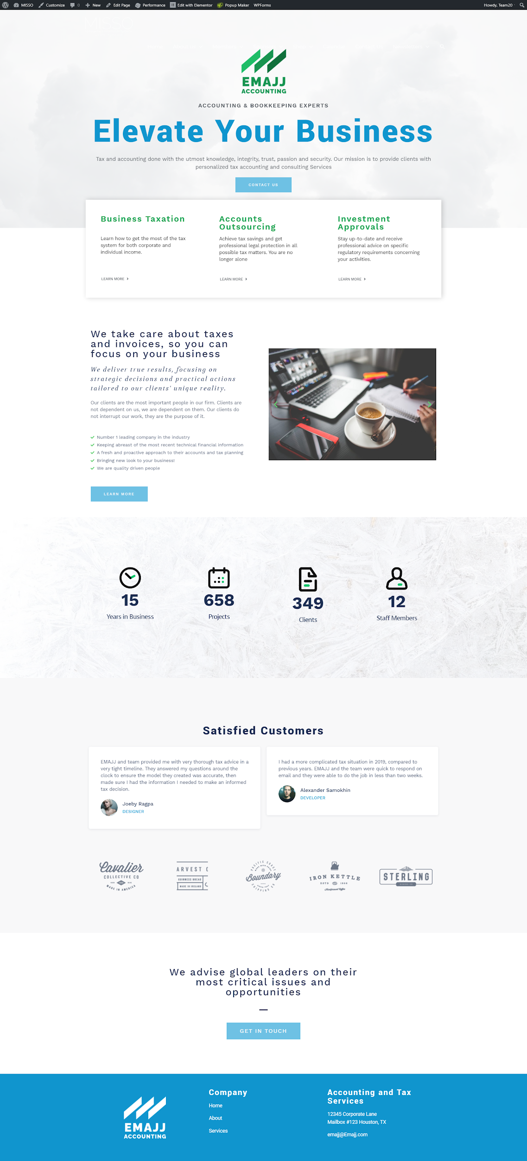
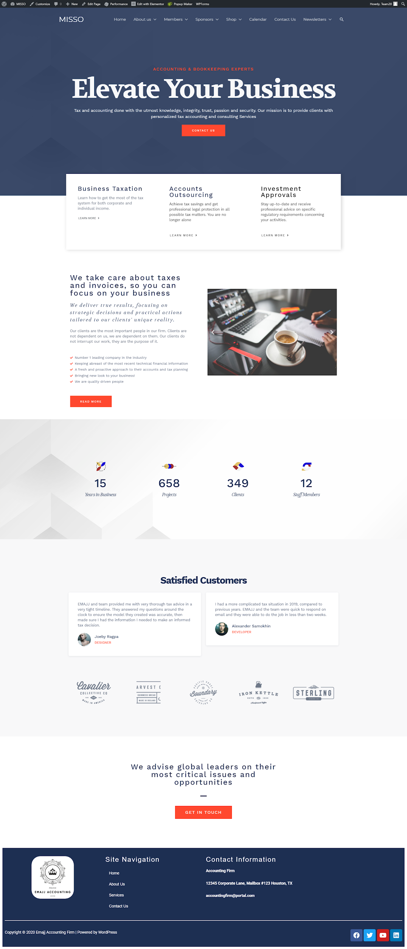
Proposals
1
2

Slide 18
DEMO
EMAJJ Accounting Wordpress

Slide 19
Conclusion
Learn new skills
Analyze Data
Be creative
Manage Time

Slide 20

Thank You
Do you have any questions?

